Slide 1
College Planning
For Juniors
January, 2022

Slide 2
To Do List:
Research College Options
Virtual visits and meetings with College Reps
SAT and ACT

Slide 3
College Research
Not sure where to start? College Board: Big Future
Visit college websites, they have the most up to date information
Contact Admissions
Meet with college reps in the Career Center
Factors to consider
Academics
Location (remote options)
Atmosphere and
Student body size
Cost (though don't rule out anything yet. You won't know the true cost until you receive the Financial Aid package after applying)

Slide 4
College Visits
COLLEGE VISITS - How to learn about colleges virtually
YouVisit: high-quality, interactive tours
spreadsheet of different ways to learn about a college virtually
Some college campuses are hosting visits by appointment only. Call the admissions office to ask if you can plan a visit.
Mrs. McDonough sets up visits with college reps. These are the same folks reading your application! Join in! This is a great way to make an impression.

Slide 5
College Entrance Exams
Many colleges went test optional for 2021 and 2022, but as of now, it is unclear what the trend will be for 2022. Each college may be different. We advise planning to take the SAT and ACT in May or June.
SAT: comprised of evidence based reading and writing, and math sections. Students should register online at www.collegeboard.org
ACT: tests English, reading, mathematics, and natural sciences. Students should register online at www.actstudent.org
Superscoring: Most colleges will combine subscores from different test dates to create a higher combined score.
Test Optional: Many schools have decided to go test optional, meaning if you provide the tests they will consider it as part of your application, but they are not required.
SUNY Updates: https://www.suny.edu/attend/apply-to-suny/testing-requirements/
SAT and ACT scores will not appear on the VVS transcript.
You can send your scores directly from College Board and ACT, or you can request we put your scores on the transcript. You must provide a printed score report for us to put the scores on your transcript.

Slide 6
SAT and ACT prep
PSAT results/ Khan Academy – Every junior who took the PSAT exam has access to My College Quickstart. Based on your results, Khan Academy will lead you through units to improve your score, focusing on the area where you need the most practice.
http://www.collegeboard.org/html/demo/
Career Center – Practice materials available in the Career Center. See Mrs. McDonough.
March 2 Success - Free site designed to help students prep for the SAT and ACT. There are full length practice tests and other practice tools such as flashcards.
https://www.march2success.com/
MVCC Prep Courses - These classes vary in price, intensity and focus. All classes are online.
https://www.ed2go.com/mvcc/SearchResults.aspx?CurrPage=1&CategoryId=1430&Sort=Relevance&PrevSort=Relevance&SortAsc=True&fbclid=IwAR2oAlSvZPPODqb4xrGgxkxnB5Kh99Q7lNe8fLpeHPX1uuvx2YfoWzZTnO0

Slide 7
Prepare for the SAT and/or ACT. Register one month prior to test date.
Visit colleges (virtual or in person)
Research colleges online. Look at the website, majors, classes required for major, etc.
Finalize your list of colleges you plan to visit and/or apply to.
Now
Jan-Feb
Jan-May
May-June
Summer
Meet with your school counselor.
Virtual visits and more research
Take the SAT and/or ACT.
Attend virtual or in person Open House events

Slide 8
Applying to College
Common Application https://www.commonapp.org/
SUNY Application https://www.suny.edu/attend/apply-to-suny/
Individual college websites
Apply between August 1 and December 1 (deadlines vary)

Slide 9
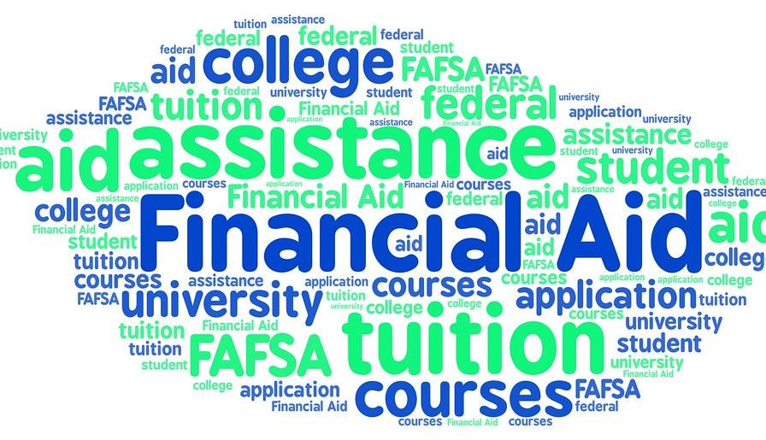
Paying for College
Everyone will need to complete the FAFSA - Free Application for Federal Student Aid. Open Oct 1
Everyone will need to complete the TAP- NY State’s Tuition Assistance Program.
CSS Profile - required by some private colleges - may be due in November
Tips on the process can be found here: https://www.hesc.ny.gov/pay-for-college/apply-for-financial-aid/apply-for-aid-start-here.html

Slide 10
Junior Scholarships
Clarkson
Elmira College
LeMoyne College
Rensselaer Polytechnic Institute
Rochester Institute of Technology
St. Lawrence
St. Michael’s College
Sage College
University of Rochester
Keuka College
Alfred University
Well’s College
College specific scholarship that are only available to juniors!
These scholarships are specific to the college listed, and are dependant on gaining acceptance into that college.
Scholarships will be posted mid February and applications are due in the beginning of March

Slide 11
Scholarships
Merit based scholarships from colleges
Check the Career Center and the Google Classroom for Class of 2023
VVS Education Foundation
Local Scholarships (in March of Senior year)
Parent employers, churches, VFW, Masons ,etc
Scholarship Search tools
College Board : https://pages.collegeboard.org/scholarship-search
Fastweb: https://www.fastweb.com/

Slide 12
Tips for Success
Spend time exploring your options
Communicate with your School Counselor: we are here to help!
Meet with College Reps
Check the Google classroom
Visit
Meet all deadlines
Start the application early ( you can start a Common App on 8/1. Get the easy questions done)

Slide 13
Questions?
Thank you!

